Slide 1
Crafting a compelling web presence
Monica Babu
BADM-MBE5

Slide 2


Slide 3
contents
Introduction
Products
Developed platform
Design
Suggestions
Best practices
Landing page
Conclusion

Slide 4
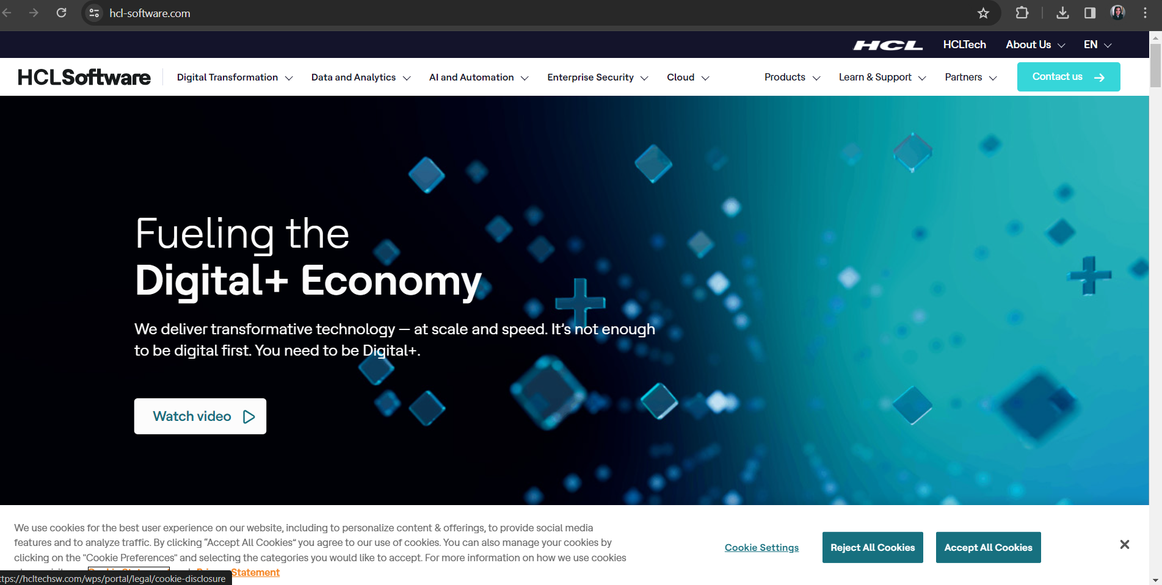
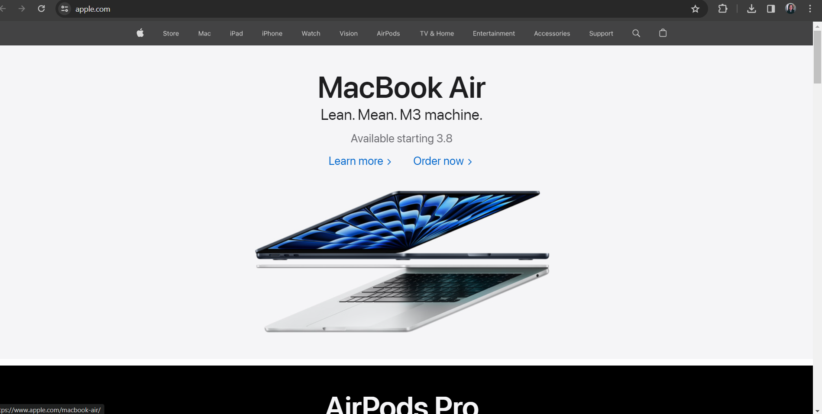
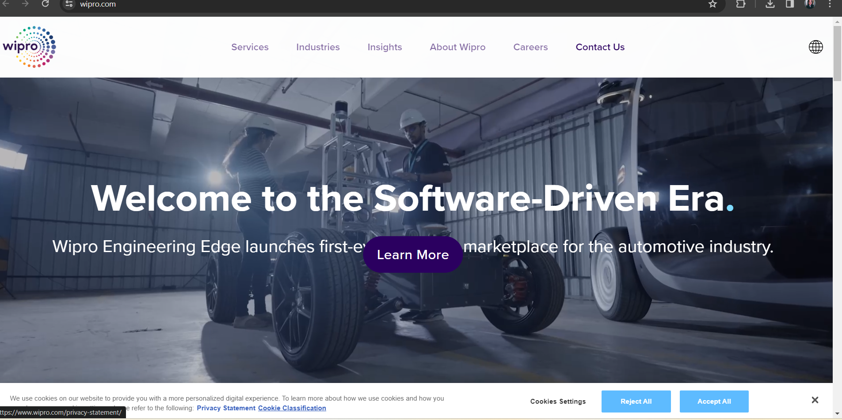
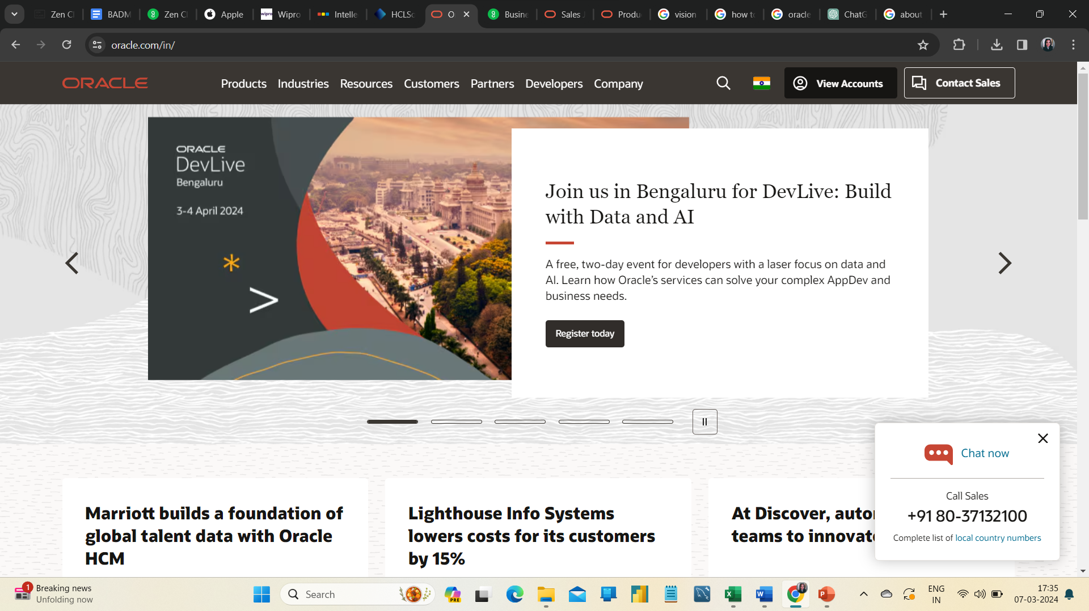
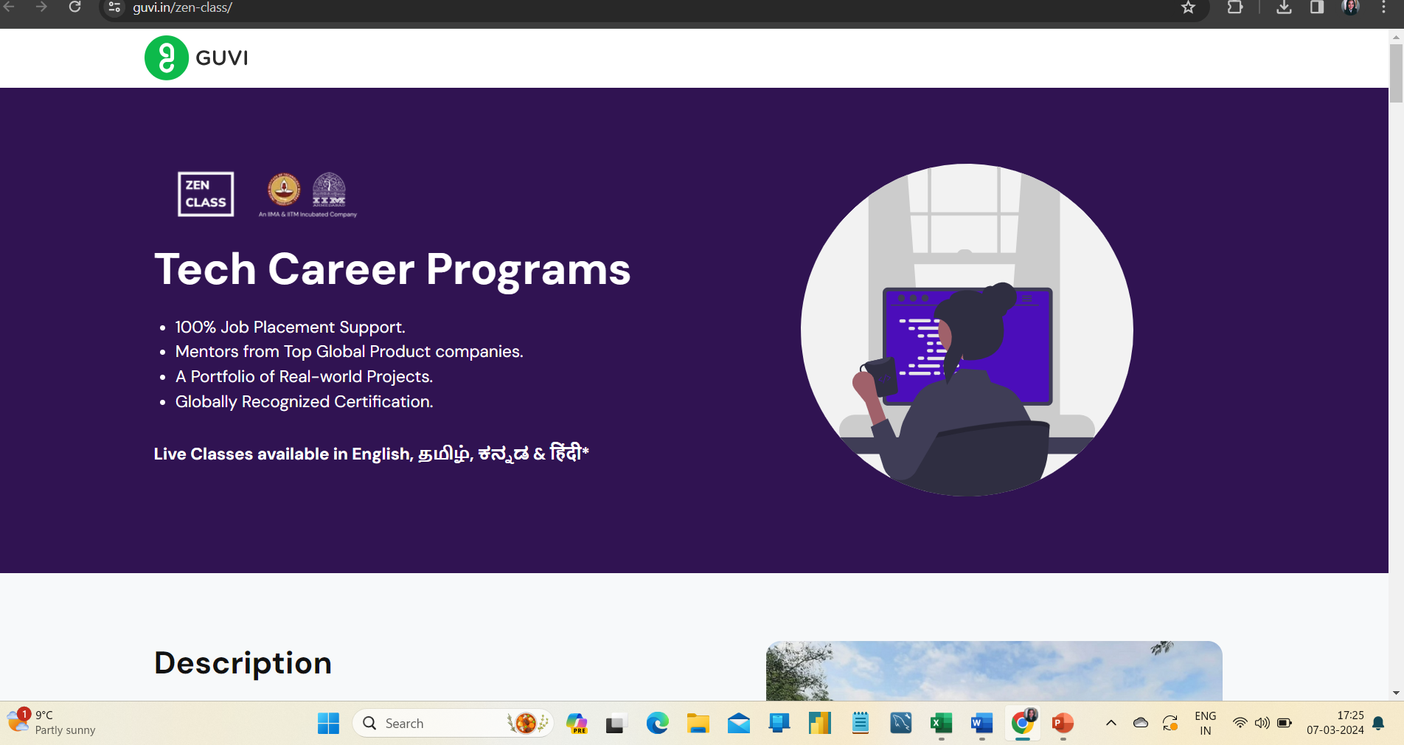
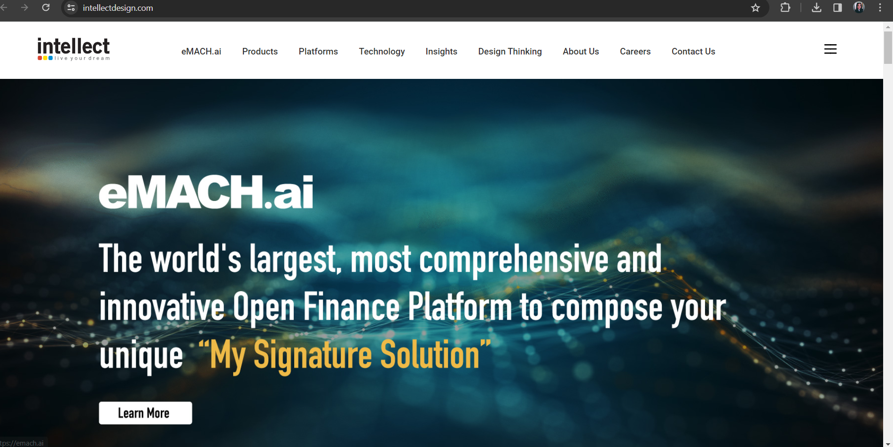
INTRODUCTION
Web designing is the process of planning, conceptualizing, and implementing the plan for designing the website of a particular firm to make it user-friendly.
Here, we are going to explore the website of ORACLE and craft some of their products/services landing pages by imposing our implementation.

Slide 5
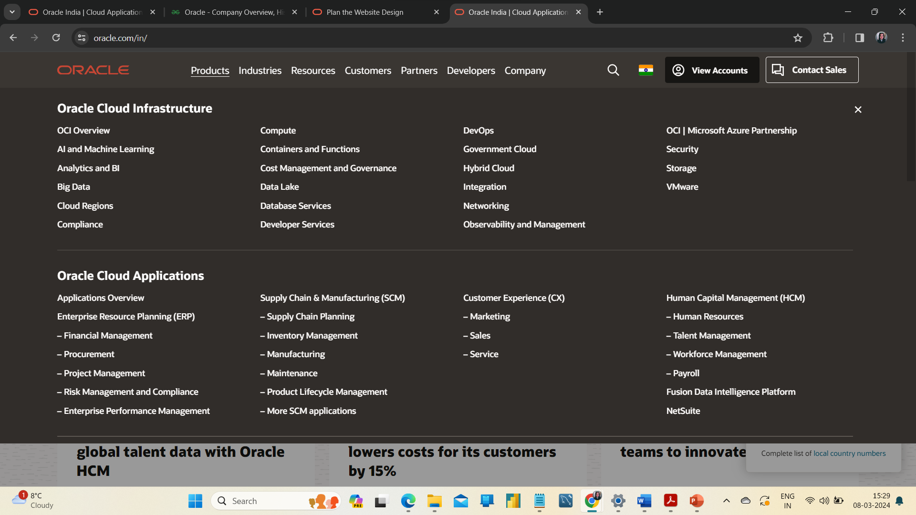
Overview of Oracle and its Products
Oracle is one of the top software companies in the world, as they design, manage, and sell software. They provide both software and hardware. Many small-scale sales and database firms rely on Oracle.
Oracle designed its website user-friendly for both Windows and mobile users.
Here, we are going to explore some of their products/services as follows,
Oracle cloud file storage
LINUX
JAVA
Retail Learning Subscription

Slide 6
Oracle cloud file storage
LINUX
Oracle cloud infrastructure(OCI) is thoroughly managed springy file arrangements, assembled for the cloud, that permit customers to shift their venture workloads to the cloud. File storage handles quantity management, enhancing the software, preservation of disk failure, and unlocking IT Managers to target business & application demands.
The organization needs exhaustive, protected IT solutions, not just another LINUX distribution. Oracle provides LINUX with everything appropriate to expand, enhance, and regulate applications on the spot, in the cloud, and at the edge. It is more secure and smoother to manage and it's tuned for ambitious Workloads at cloud scale.

Slide 7
JAVA
RETAIL LEARNING SUBSCRIPTION
Oracle Java is the #1 programming language and development platform. it cuts down costs, compresses the evolution period, initiates modernization, and improves application services. More than a million developers worldwide use Java to run virtual machines. Enterprises and developers prefer Java as development platform.
Enlarge your ability to manage core retail processes of Oracle solutions through automated courses usable anytime, anywhere. For your stable base of mastery in your daily endeavor, you can start your journey with on-demand training.

Slide 8
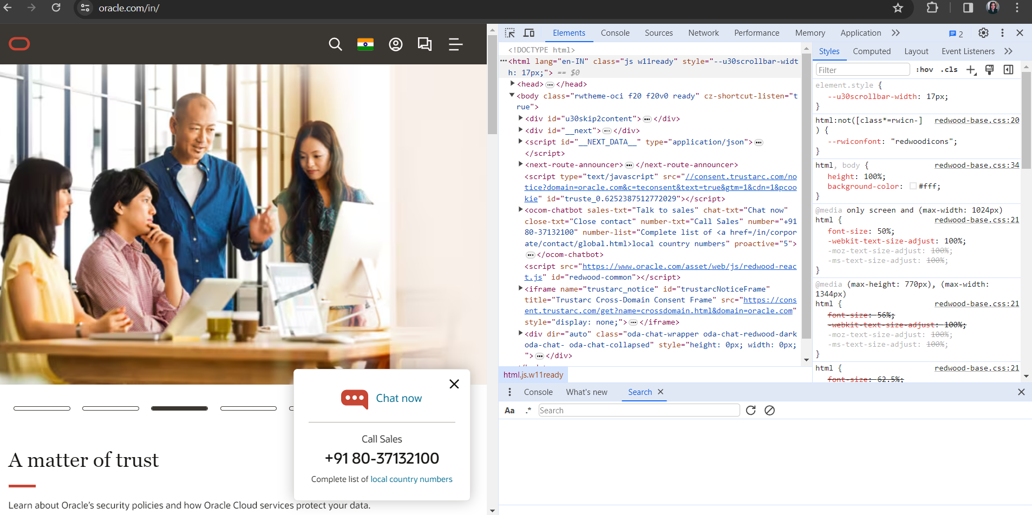

ORACLE WEBSITE HAD BEEN DEVELOPED USING (JAVASCRIPT) REACT.JS
HANDLEBARS
NEXT.JS

Slide 9

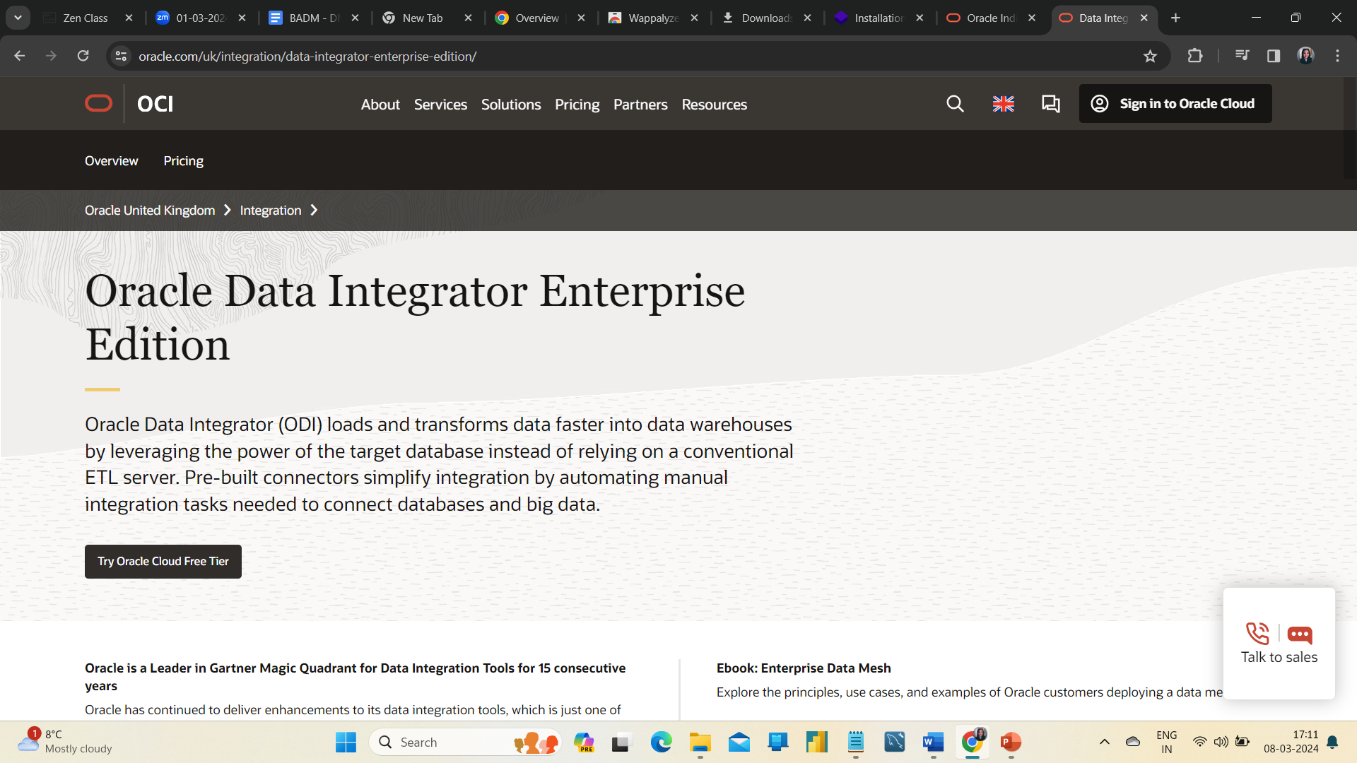
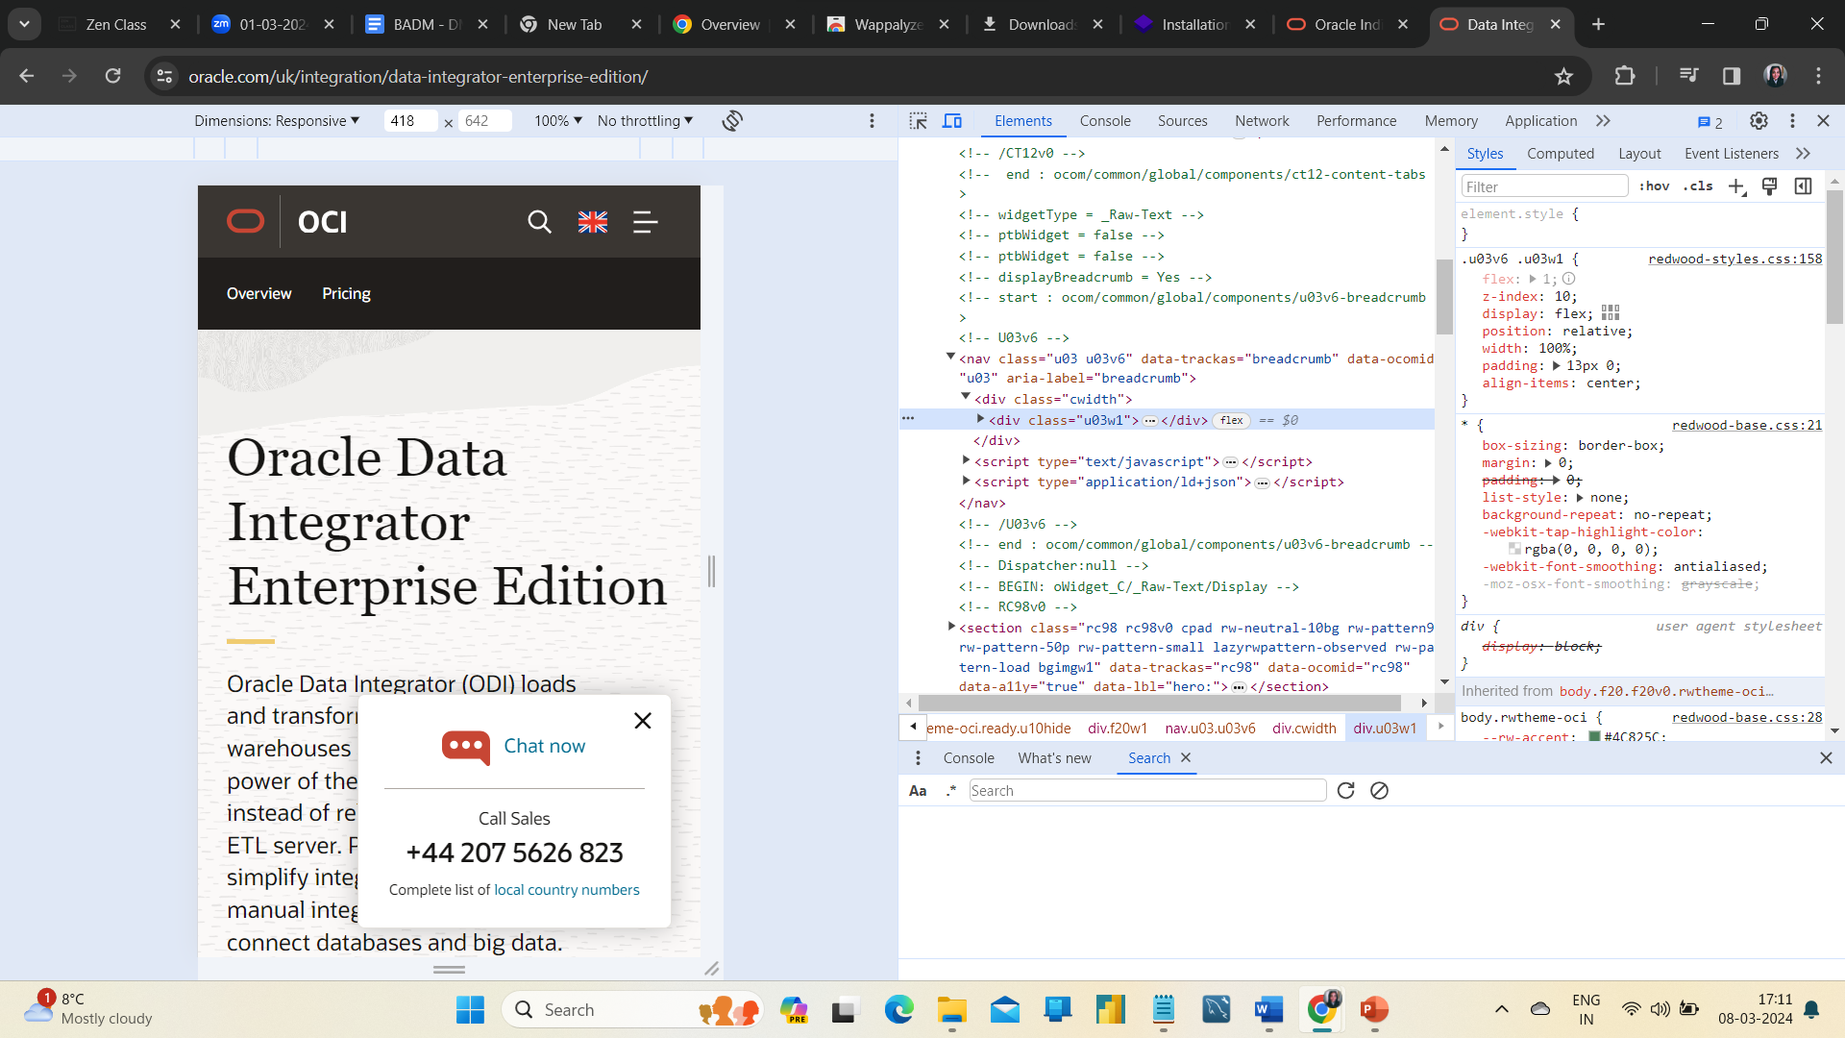

Slide 10
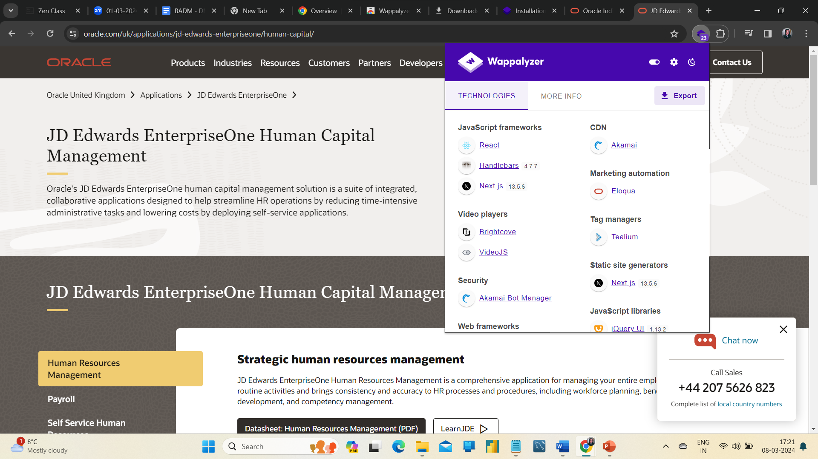
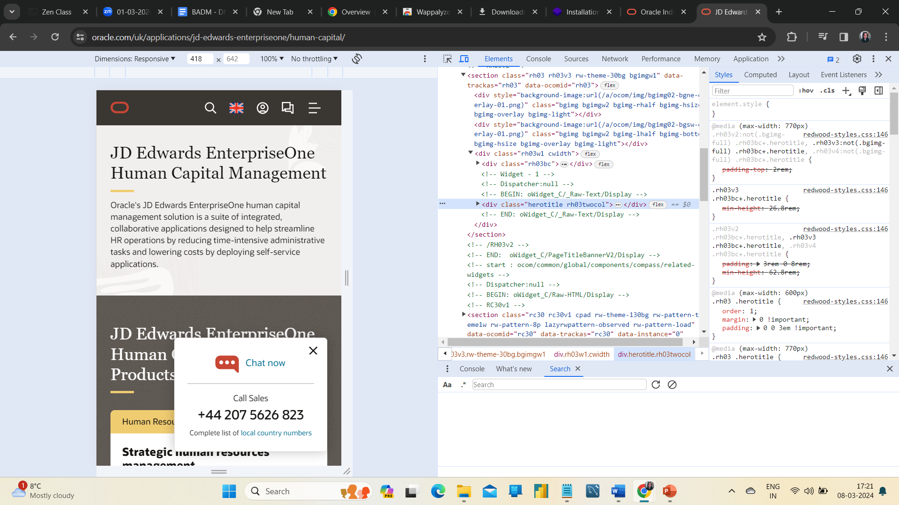

Slide 11
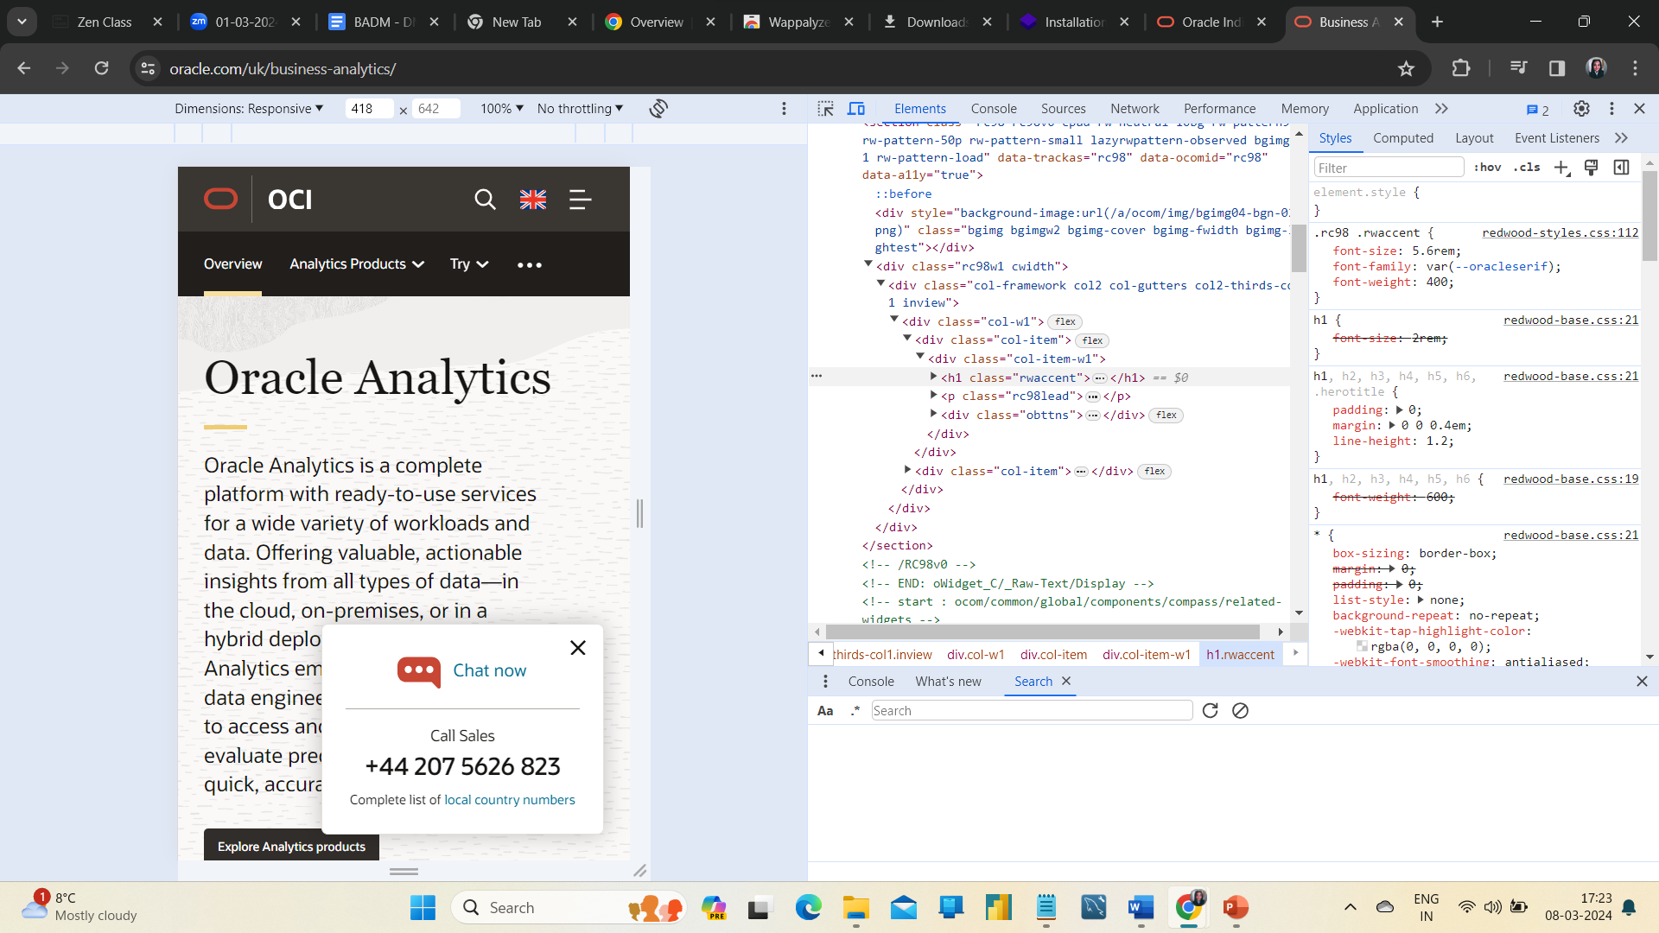
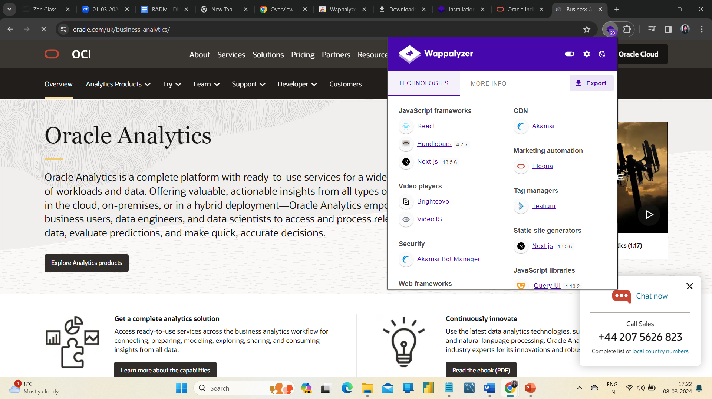

Slide 12
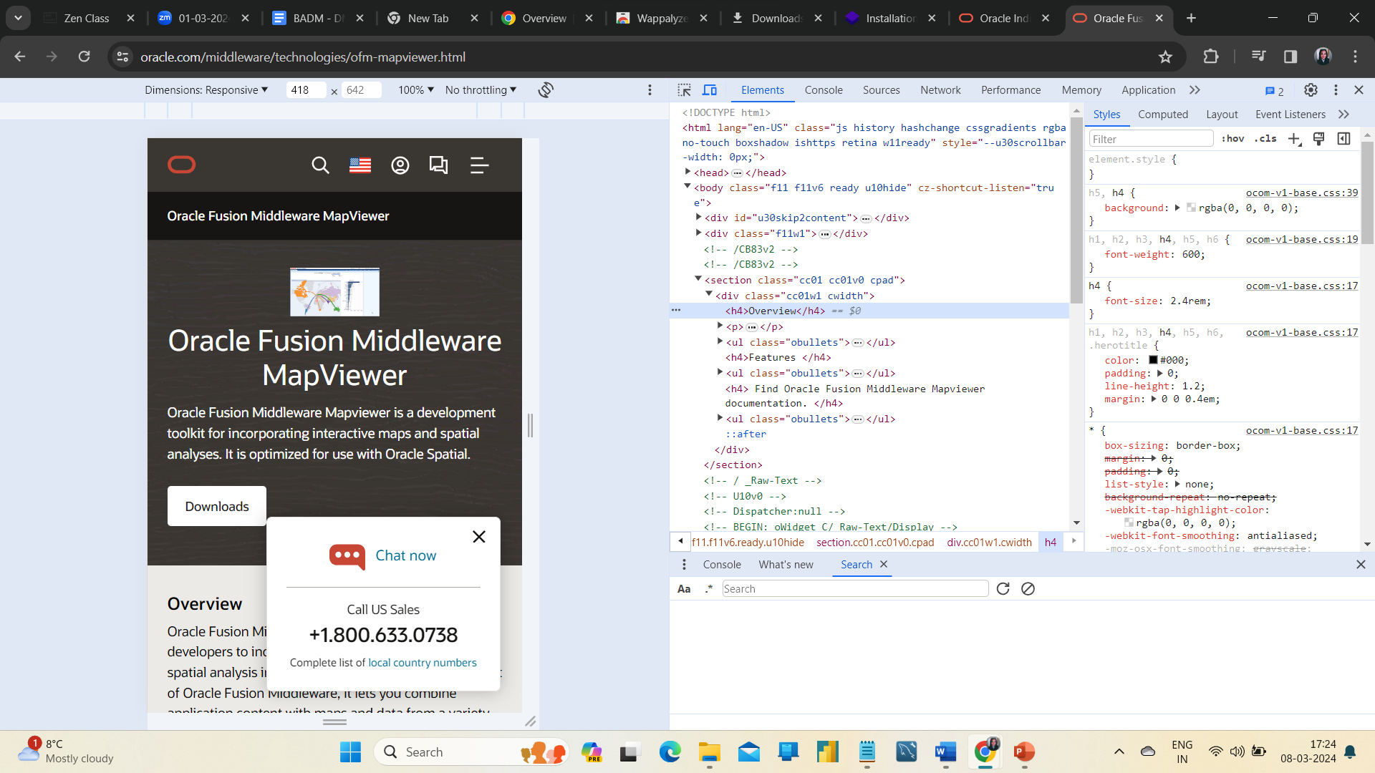
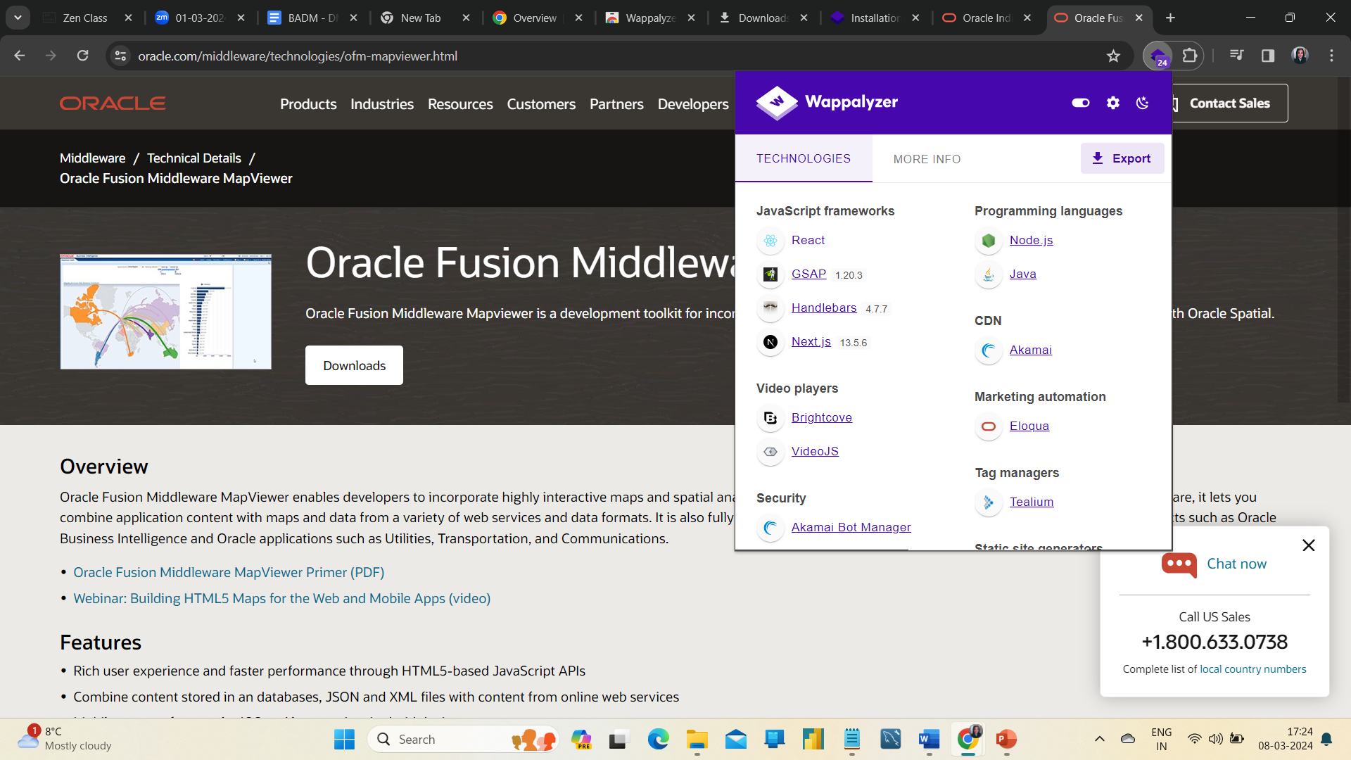

Slide 13
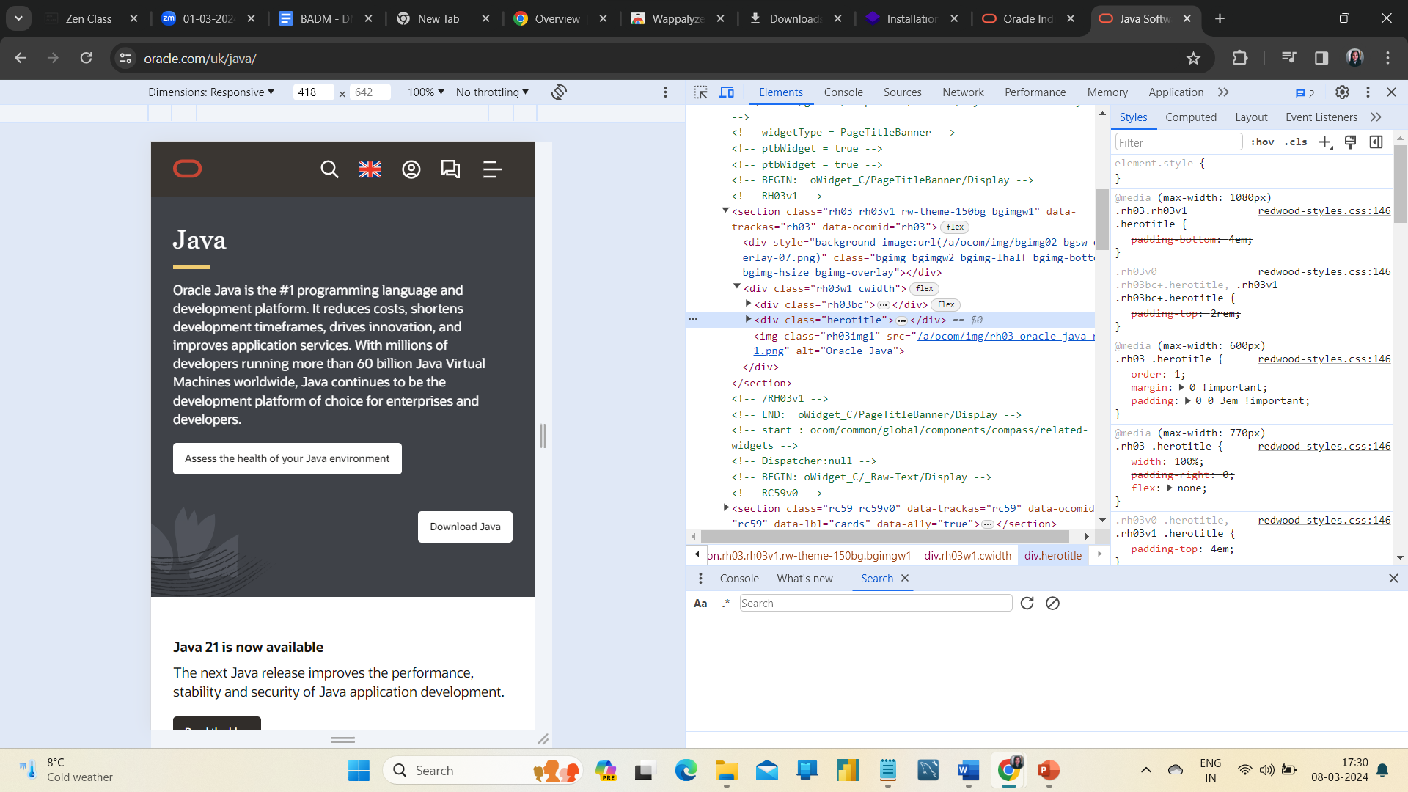
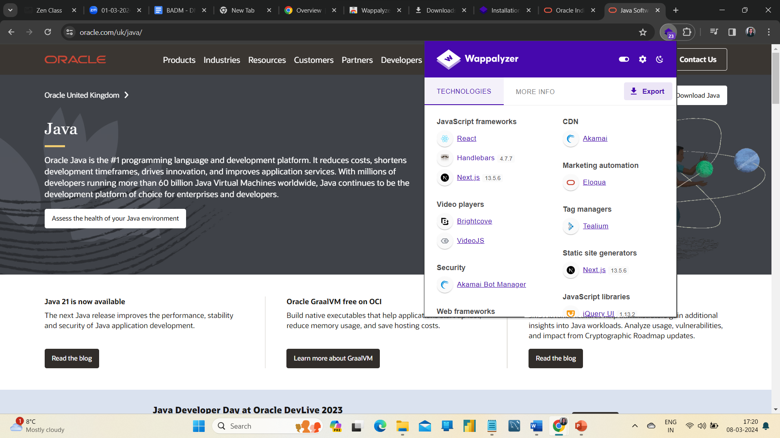
Some of the online tools use for checking websites while working professionally as follows,
Tricentis
Responsinator
Dynamic yield
Screenfly
Cross browser testing.

Slide 14
Suggestions
Customer service pop-up had been displaying continuously on the home page even after you closed. The desktop view is better, whereas in the mobile view, it annoys the user.
Some of their product landing page lacks detailing.
On the homepage, once clicking on headings, it doesn't go to a landing page, just shows us the topics. it will be better if they create a separate landing page for Headings.
A single website with more subcategories is a little bit clustered.
Even the home page needs some more informative layouts.

Slide 15
Best practices for an appealing website
High-Quality images
Create a colour schema
Use typography effectively
Explore plug-ins widely
Mix up the layout
Use clean easy to read fonts
Make the website simple and elegant
Short and clear descriptions of products
Make it clutter-free
Don’t make complicated pages
Create pages user-friendly etc.,
These are some of the practise and there are more things to explore in website designing.

Slide 16
Conclusion
Here I conclude with the Landing Page for Oracle Product ADVERTISING.
https://www.figma.com/file/OMlEZNqDnzC9wENilEJtgV/lANDING-PAGE?type=design&node-id=0%3A1&mode=design&t=TNBbspsUSuglolBf-1

